Slide 1
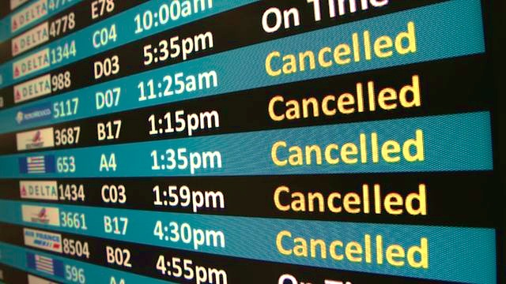


Predicting the Likelihood of Flight Cancellations
Aashish Jain, PhD
Data Science Intensive Capstone Project, May 29th 2017 Cohort
Thanks to Springboard mentors
Hassan Kingravi, Pindrop Labs
Srdjan Santic, RCC, University of Belgrade

Slide 2
The Problem
Total flights in two years (2015 and 2016) in top 20 airports:
2.85+ millions
Cancellation rate:
1.14% (≅32,600 flights)
Even though 1.14% is a small number, one rare event causes lot of troubles to passengers
What factors affect flight cancellation rate?
Can we predict the likelihood of a flight getting cancelled?

Slide 3





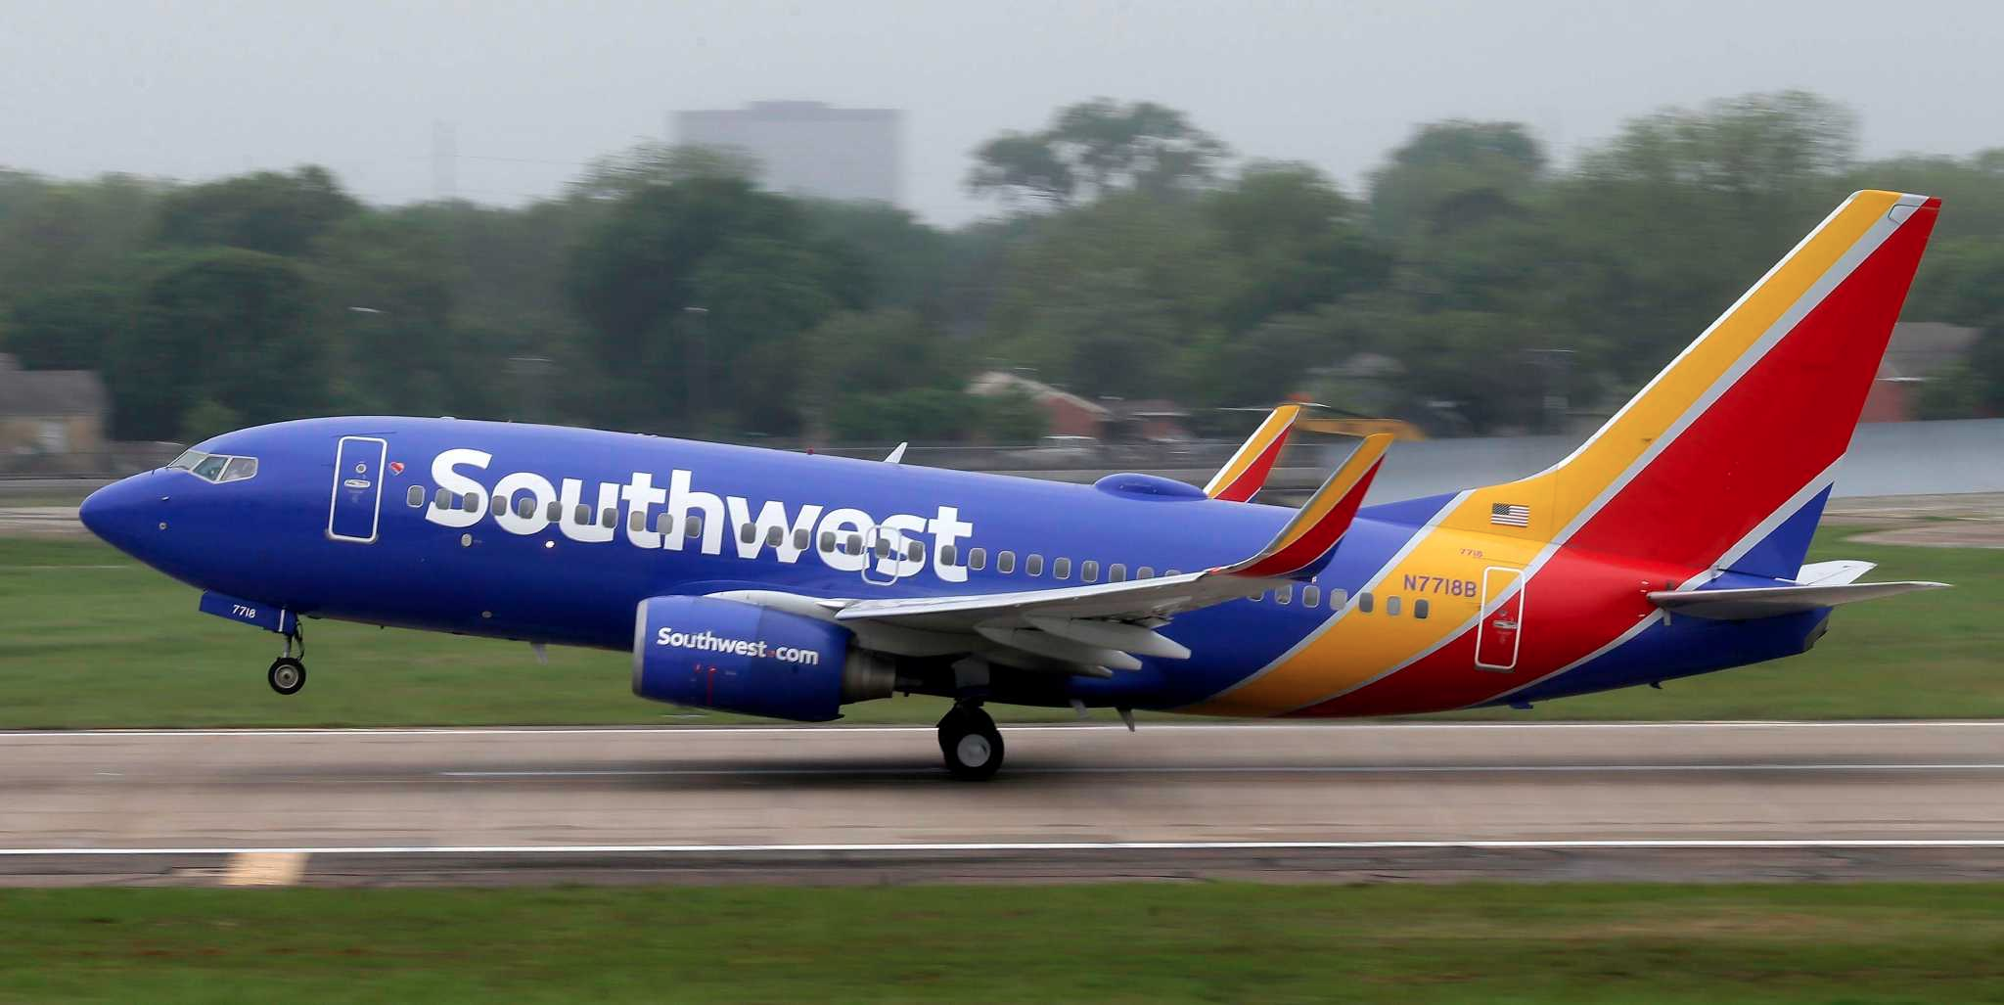

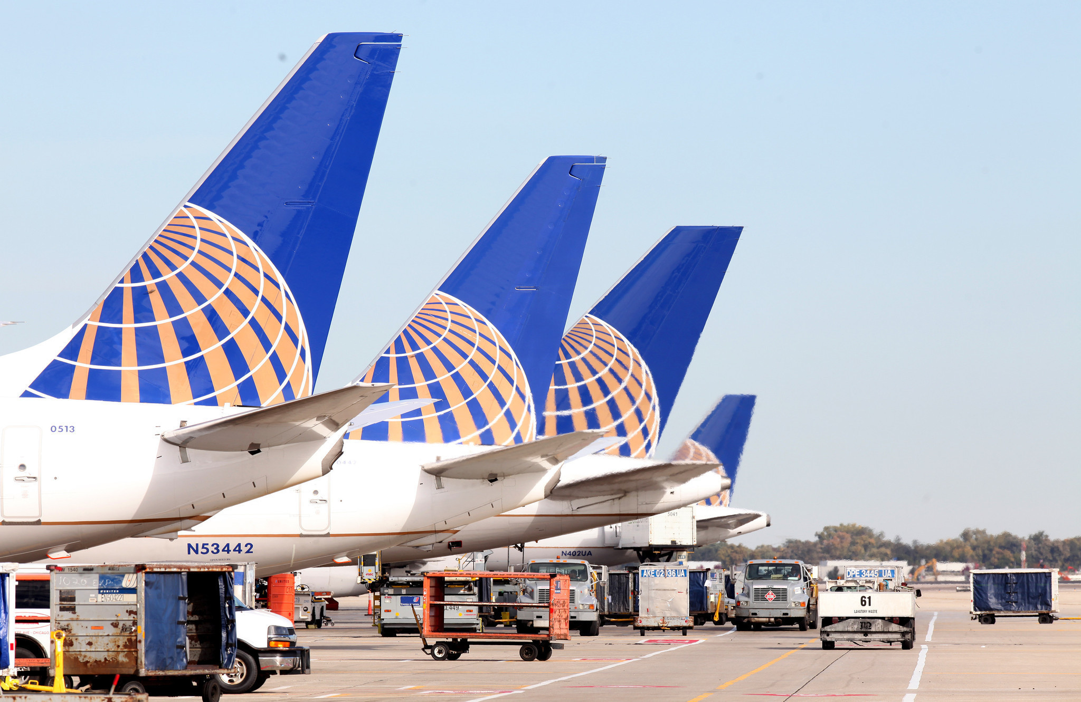

Who might care?
Travel Agencies
Airlines
Mobile Apps
…and many more…

Slide 4
What factors might affect flight cancellations?
Flight schedules: departure and arrival dates and times
Flight length: distance, flight times
Bureau of Transportation Statistics
Flight Data
Airline carriers
Airport locations: both origin and destination
Data Source
Weather conditions: both origin and destination
Temperature, humidity, wind speed, pressure, etc..: both origin and destination
Weather Data
Wundergound.com API

Slide 5
Data Information
Data acquired for the period: January 2015 – December 2016
Flight and weather data for: Top 20 airports in the US
Number of records: 2,857,139
Number of fields: 90
Data Acquisition and Merging
https://github.com/aajains/springboard-datascience-intensive/tree/master/capstone_project/DataAcquisitionMerging
Flight Data Specifics
Source: Bureau of Transportation Statistics
Data can be downloaded for one month at a time
File format : csv
Concatenate files from all months into one
Each record: a unique flight
Weather Data Specifics
Source: Wunderground.com API
File format : XML (hourly data available)
One API call: One day data for a chosen airport
Concatenate files from days into one, for an airport
Each record: weather details for an airport at a given hour
Merge them together using following keys:
Flight date at origin and destination
Origin and destination airport names
Scheduled departure and arrival times

Slide 6
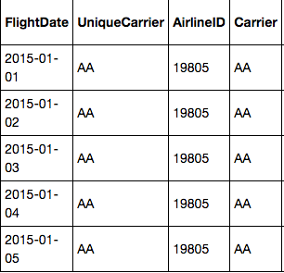
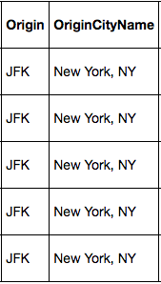
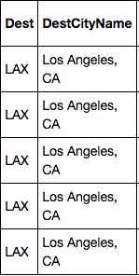
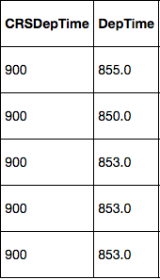
Engineering Flight Historical Performance Features From Flight Data
https://github.com/aajains/springboard-datascience-intensive/blob/master/capstone_project/DataAcquisitionMerging/history_calc.ipynb
Steps for each flight:
Store the date of the flight in question: "thisDate”
Get Carrier, Origin, Destination, and Departure time
Filter the dataset based on 4 values found in step 2
Filter the filtered data further to get a subset of the data with only those dates that are "ndays" prior to "thisDate". Here, "ndays" is the number of days that we want to calculate the history for.
Use the ndays filtered dataset and perform aggregations such as count of cancelled flights, median of departure delays etc.. We used ndays = 10, 20 and 30.
These aggregated results are then added as new fields/features to original dataset.

Slide 7
Data Exploration https://github.com/aajains/springboard-datascience-intensive/blob/master/capstone_project/EDA/ExploratoryDataAnalysis_v1.ipynb
Flight schedules Airports Airlines Flight distance
Weather factors
Flight historical performances

Slide 8
Flight Cancellation Rate: Definition
Number of flights and cancellations on a daily basis
Cancellation rates on a daily basis
Here, a given scenario corresponds to a date. A scenario could be a weather condition, or a specific airline, or an airport, or a day of week, etc..

Slide 9
Flight schedules Airports Airlines Flight distance

Slide 10
Flight Schedules
Monthly cancellation rates
Weekly cancellation rates
Hourly cancellation rates

Slide 11
Airports and Airlines
ATL Atlanta, GA
BOS Boston, MA
BWI Baltimore, MD
CLT Charlotte, NC
DEN Denver, CO
DFW Dallas/Fort Worth, TX
DTW Detroit, MI
EWR Newark, NJ
IAH Houston, TX
JFK New York, NY
LAS Las Vegas, NV
LAX Los Angeles, CA
LGA New York, NY
MCO Orlando, FL
MSP Minneapolis, MN
ORD Chicago, IL
PHX Phoenix, AZ
SEA Seattle, WA
SFO San Francisco, CA
SLC Salt Lake City, UT
Airports
MQ - Envoy Air
EV - ExpressJet Airlines
US - US Airways
NK - Spirit Airlines
AA - American Airlines
B6 - Jetblue Airways
UA - United Airlines
OO - SkyWest Airlines
WN - Southwest Airlines
VX - Virgin America
DL - Delta Air Lines
F9 - Frontier Airlines
AS - Alaska Airlines
Airlines

Slide 12
Flight Distance

Slide 13
Weather factors

Slide 14
Temperature, Humidity and Wind Speed
Temperature
Humidity
Wind speed

Slide 15
Wind Direction
0⁰ : North, 90⁰: East, 180⁰: South, 270⁰: West

Slide 16
Weather Conditions

Slide 17
Flight historical performances

Slide 18
Cancellation and Diversion History

Slide 19
Some Historical Indicators
Temporary flight: A flight which has history of no flights in lasy ndays
All cancelled: A flight which has history of 100% cancellations
All diverted: A flight which has history of 100% diversions

Slide 20
Departure and Arrival Delay History
Departure Delay
Arrival Delay

Slide 21
Machine Learning Modeling https://github.com/aajains/springboard-datascience-intensive/tree/master/capstone_project/Modeling

Slide 22
Modeling Overview
Type: Supervised learning
Binary classification: 1 for cancelled and 0 for non-cancelled flights
Highly imbalanced data: 1.14% data tagged with class 1
Needs special attention
Tools: Python’s scikit learn and imblearn

Slide 23
Modeling Steps
Data pre-processing steps:
Label encoding
Data splitting into training and test sets (50%-50%)
Resampling or weighting the training data to take care of imbalanced problem
Scaling
Cross validation (CV) for hyperparameter tuning:
5 fold cv
Using scikit-learn’s grid search method
Evaluation metric: Area under precision recall curve
Performance evaluation using holdout dataset
(50% of the whole data)
Testing using the same pipe
(excluding cross validation)
Classifier training using optimal parameters and 50% of the whole data
These steps piped using imblearn’s pipeline class

Slide 24
Resampling/Weighting Techniques Used:
Resampling techniques (imblearn):
Random under-sampling (RUS)
Synthetic Minority Oversampling Technique (SMOTE)
Weighting technique (sklearn):
Using class_weight (=‘balanced’) parameter in several scikit-learn’s classifier implementations
Classification Algorithms Used:
Logistic Regression – RUS works best
Gaussian Naïve Bayes – RUS works best
Random Forest – class_weight = ‘balanced’ works best
Gradient Boosting – SMOTE works best
Extremely Randomized Trees – class_weight = ‘balanced’ works best

Slide 25
Model Comparisons
LR: Logistic Regression, GNB: Gaussian Naïve Bayes, RF: Random Forest, GB: Gradient Boosting, ET: Extremely Randomized Trees

Slide 26
Model Comparisons
Logistic Regression is the worst and Extremely Randomized Trees is the best

Slide 27
Some Details on the Best Model (ET)
Before optimizing number of trees and set of features.
We used 50 trees and all 67 features (note that we removed some features after merging various datasets)
After optimizing number of trees and set of features.
Optimum number of trees: 50
Optimum number of features: 31
Used one-hot encoding (OHE), leading to 295 features
How did we optimize number of trees and set of features?

Slide 28
Some Details on the Best Model (ET)
Optimizing number of trees
Optimizing set of features
Top 20 features

Slide 29
Testing on Under-sampled Test Data
LR: Logistic Regression, GNB: Gaussian Naïve Bayes, RF: Random Forest, GB: Gradient Boosting, ET: Extremely Randomized Trees

Slide 30
Testing on Under-sampled Test Data
Logistic Regression is the worst and Extremely Randomized Trees is the best

Slide 31
Using the Model
Select the top 31 features from the dataset.
Note that Ncan_10, Ncan_20 and Ncan_30 are not originally present in any dataset. One needs to calculate (or engineer) them beforehand
Perform one-hot encoding on categorical variables
Use model pipeline on the new data and predict probabilities for flight cancellation

Slide 32
An Example of Model Usage: Possible Recommendations

Slide 33
Assumptions, Limitations and Disclaimers
We assume that all flights are independent, though there might be some time-correlations
Used only 20 airports and two years of data
The model will behave poorly if we try to predict cancellations of flights that are scheduled too far in future
The flight data does not contain all airlines data (e.g. Sun Country Airlines data is missing in the current flight dataset)

Slide 34
More Ideas to Improve the Model in Future
Engineer more features related with airports such as number of runways, airport capacity, airport infrastructure, etc.
Extract more information about airlines such as their ratings, stock market performance etc., to get more features
Similar to flight historical performances, generate features with airport historical performances
Use social network and news media to extract sentiments about airlines and airport to get more features

Slide 35
Conclusions
All sources of datasets contributed to the predictive power of the model.
Out of 5 supervised classification models, the Extremely Randomized Trees provided the best results.
Out of 67 features, we used only 31 features for the best model with 12 from the flight data, 16 from the weather data and 3 from the flight historical performances data (which we engineered).
With 50%-50% splitting, the test data set gave ROC AUC = 0.89.
With more ideas, the model can be improved in the future.

Slide 36
Thank you!
Aashish Jain, PhD
Email: aajains@gmail.com
https://www.linkedin.com/in/aashishjain/
https://github.com/aajains/
Project report: https://github.com/aajains/springboard-datascience-intensive/blob/master/capstone_project/Report/CapstoneReport.pdf

